Slide 1
Job Candidate Screening Model
Data Collection from Youtube Users
Baselines Model
BU-NKU Model
TUD Model
Submitted by:
Rahul Tripathi
Saket Suman

Slide 2
Data Set explanation
First Impressions data set comprises 10,000 clips (with an average duration of 15s) extracted from more than 3,000 diﬀerent YouTube high-deﬁnition (HD) videos of people facing a camera and speaking in English. People in videos have diﬀerent gender, age, nationality, and ethnicity.
Videos were labeled by the attonators both with apparent personality traits and a“job-interview variable”.
During labeling, diﬀerent pairs of videos were given to diﬀerent and unique annotators. Around 2500 annotators labelled the data, and a total of 321,684 pairs were used
Annotators had to answer give their answers whether they would invite the one candidate or other judging by personality traits.
We post-processed the rankings provided by the annotators to generate scores for each annotated variable. By doing so, cardinal scores were obtained by pairwise ﬁtting a Bradley-Terry-Luce (BTL) model .

Slide 3
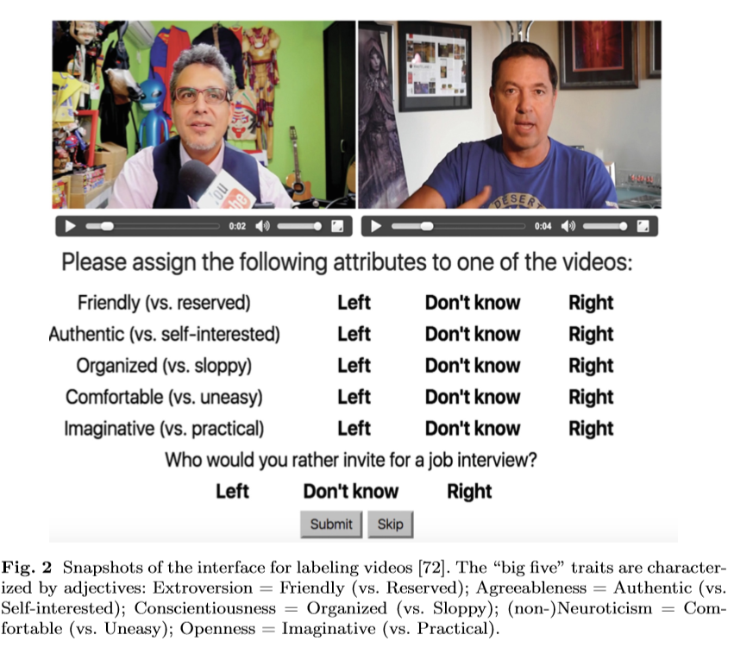
As shown in image attotators were asked to compare between the two videos in pair about OCEAN and interview variable. They can answer in “Left”, “Right” and “Don’t Know”.
Small-world algorithm was used for sampling the pairs that workers had to annotate.
To estimate the consistency of the personality assessments in the dataset we ran a second experiment with 12 participants (6 males and 6 females, mean age = 27.2). Who viewed same set of 100 videos.
To measure consistency, for each video pair, entropy was calculated ,of the distribution of the choices of the participants, and averaged the results per each personality trait
Low avg entropy - high consistency
High avg entropy - low consistency

Slide 4
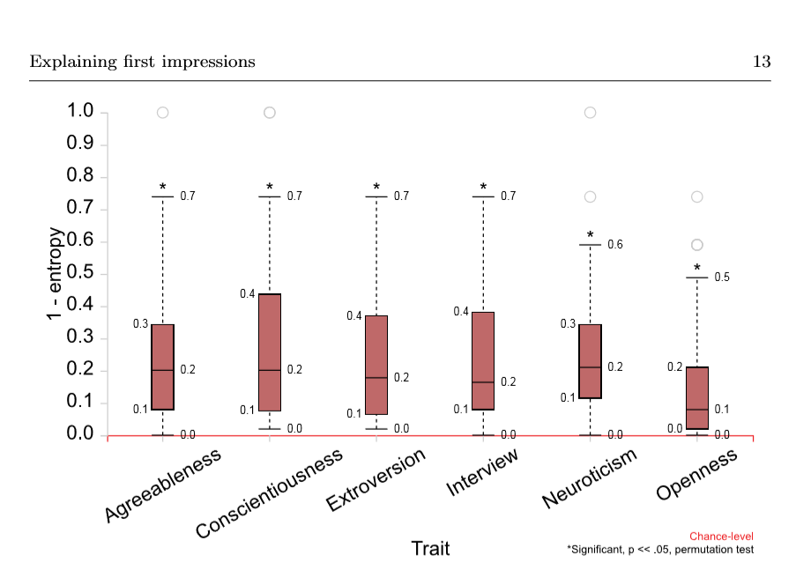
Results reveal that all traits were consistent. These are displayed in the graph shown.
This Data collected was used as a ground truth values.
Input was the video clips seeing which we needed to make predictions.

Slide 5
Baselines Model
We considered several baselines for solving the above tasks in different input modalities. Here, we briefly describe the baseline models. Briefly, many factors including face features, gender, audio features and context have varying contributions to the predictions of different traits.
Language models- audio transcripts:
We evaluated two different language models, each on the same modality (transcriptions). Both of the models were a variation of the following (linearized) ridge regression model: y = embedding (x) 𝛽+𝜀, where y is the annotation, x is the transcription, 𝛽 represents the parameters and 𝜀 is the error term.
Bag-of-words model: This model uses an embedding that represents transcripts as 5000-dimensional vectors, i.e. the counts of the 5000 most frequent non-stopwords in the transcriptions.
Skip-thought vectors model: This model uses an embedding that represents transcripts as 4800-dimensional mean skip-thought vectors of the sentences in the transcriptions.

Slide 6
Sensory models-audio visual information processing:
We evaluated three different sensory models, each on a different modality
(audio, visual, and audio visual, respectively). All models were a variation of
the 18-layer deep residual neural network.
Audio model: This model is a variant of the original ResNet18 model, in which nxn inputs, kernels, and strides are changed to n^2 x1 inputs, kernels, and strides.
Visual model: This model is a variant of the original ResNet18 model, in which the size of the last layer is changed to account for the different number of outputs.
Audiovisual model: This model is obtained by a late fusion of the audio and visual models.
Language and sensory model:
Skip-thought vectors and audiovisual model: This model is obtained by a late fusion of the pretrained skip-thought vectors and audiovisual models.

Slide 7
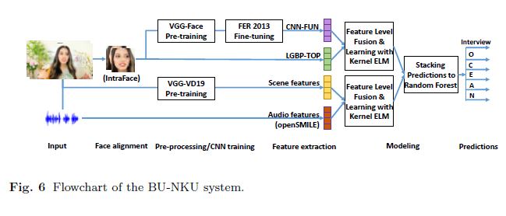
BU-NKU Model
The BU-NKU system is based on audio, video, and scene features.The qualitative stage inputs the final predictions from the system proposed for the quantitative stage, discretizes them using the training set mean scores of each target dimension, then maps the binarized (low/high) personality traits to the binarized (invite/do not invite interview variable via a decision tree (DT). DT is employed to allow visualization and ease of interpretation for the model, hence allow explainability for the decision. Finally the DT is traced to generate a verbal explanation

Slide 8
A wider but brief summary of the components used in this system is provided in the subsequent subsections.
Quantitative System:
Facial features are extracted over an entire video segment and summarized by functionals. Scene features, however, are extracted from the first image of each video only. The assumption is that videos do not stretch over multiple shots.
Face Features: Faces are detected on all frames of the video input. The Supervised Descent Method (SDM) is used for face registration, which gives 49 landmarks on each detected face.The roll angle is estimated from the eye corners to rotate the image accordingly. Then a margin of 20% of the interocular distance around the outer landmarks is added to crop the facial image. Each image is resized to 64 x64 pixels.After aligning the faces, image-level deep features are extracted from a convolutional neural network trained for facial emotion recognition. To prepare this feature extractor, the system starts with the pre-trained VGG-Face network.Then this network is ne-tuned for emotion, using more than 30K

Slide 9
training images of the FER-2013 dataset. The nal trained network has a 37-layer architecture (involving 16 convolution layers and 5 pooling layers). The response of the 33rd layer is used, which is the lowest-level 4096 dimensional descriptor.After extracting frame-level features from each aligned face, videos are summarized by computing functional statistics of each dimension over time. The functionals include mean, standard deviation, offset, slope, and curvature. Offset and slope are calculated from the first order polynomial fit to each feature contour, while curvature is the leading coefficient of the second order polynomial. In the BU-NKU approach, deep facial features are combined with the Local Gabor Binary Patterns from Three Orthogonal Planes (LGBP-TOP) video descriptor, shown to be effective in emotion recognition. It is extracted by applying 18 Gabor filters on aligned facial images with varying orientation and scale parameters.
Scene Features: In order to use ambient information in the images, a set of features is extracted using the VGG-VD-19 network , which is trained for an object recognition task on the ILSVRC 2012 dataset. Similar to face features, a 4096-dimensional representation from the 39th layer of the 43-layer architecture is used.This gives a description of the overall image that contains both face and scene.

Slide 10
Acoustic Features: The open-source openSMILE tool is popularly used to extract acoustic features in a number of international paralinguistic and multimodal challenges.The BU-NKU approach uses the toolbox with a standard feature configuration that served as the challenge baseline sets in INTERSPEECH 2013 Computational Paralinguistics Challenge. This configuration was found to be the most effective acoustic feature set among others for personality trait recognition.
Model Learning: In order to model personality traits from audio-visual features, kernel extreme learning machines (ELM) were used, due to the learning speed and accuracy of the algorithm. Initially, ELM is proposed as a fast learning method for Single Hidden Layer Feedforward Networks (SLFN): an alternative to back-propagation . To increase the robustness and the generalization capability of ELM, a regularization coecient is included in the optimization procedure.
Score Fusion: The predictions of the multi-modal ELM models are stacked to a Random Forest (RF), which is an ensemble of decision trees (DT) grown with a random subset of instances (sampled with replacement) and a random subset of features. Sampling with replacement leaves approximately one third of the training set instances out-of-bag, which are used to cross-validate the models and optimize the hyper-parameters at the training

Slide 11
stage. The cross validation gives an unbiased estimate of the expected value of prediction error. Audio-Scene Feature -level Fusion model system renders a test set performance of 0.9209 for the interview variable
2. Qualitative System:
For the qualitative stage, the nal predictions from the RF model are binarized by thresholding each score with its corresponding training set mean value. The binarized predicted OCEAN scores are mapped to the binarized ground truth interview variable using a decision tree (DT) classier. The use of a DT is motivated by the fact that the resulting model is self-explanatory and can be converted into an explicit recommender algorithm using “if-then” rules. The illustration of the trained DT is given in Figure below:

Slide 12
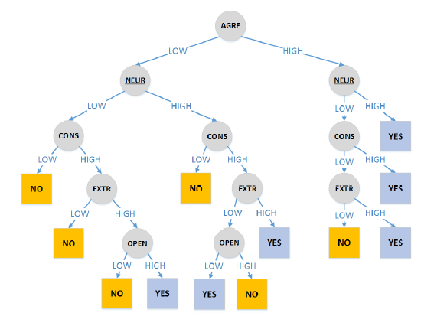

Slide 13
TUD Model
This model employs features that can easily be described in natural language, with a linear (PCA) transformation to reduce dimensionality, and simple linear regression models for predicting scores, such that scores can be traced back to and justiﬁed with the underlying features. This feature describes problem and explains the approach qualitatively.
Basic Features of Model:
The model considers two modalities, visual and textual, for extracting features.
Visual
Facial Movement
Facial Expressions
Textual
Speaking Density
Linguistic Sophistication
Figure for Overall TUD Model is given below:

Slide 14
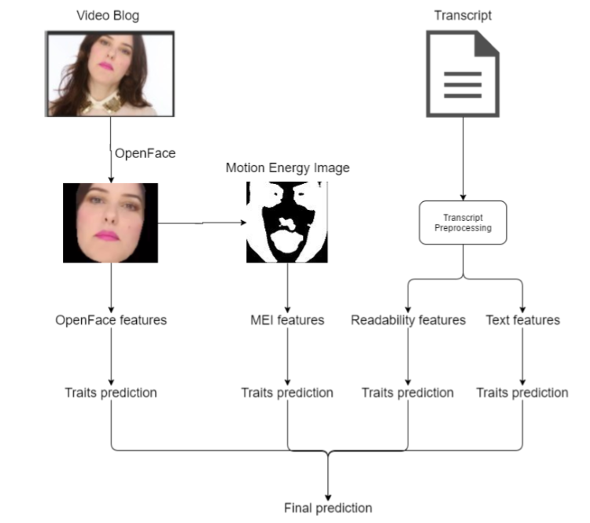

Slide 15
Visual Features
To extract only the facial movement and expressions a toolkit named OpenFace was used. .OpenFace is an open source toolkit which does not only segment faces, but oﬀers a feature extraction library that can extract and characterize facial movements and gaze.
OpenFace maked use of Action Units(AUs) that construct facial expressions encoded in Facial Action Code System (FACS)
AUs can be described in two ways:
in terms of presence (indicating whether a certain AU is detected in a given time frame)
in terms of intensity (indicating how intense an AU is at a given time frame).
For each of these AUs, three features were constructed for input to the system:
percentage of time frames is computed, during which the AU was visible in a video
the maximum intensity of the AU in the video was stored
the mean intensity of the AU over the video was also recorded

Slide 16
In order to capture overall movement of the vlogger’s face, a Weighted Motion Energy Image (wMEI) is constructed from the resulting face segmented video.
the whole video frame is used as an input to compute wMEI, which makes background movement contribute to the overall wMEI measurements
There are cases in which the resulting wMEI is all white due to background or camera movements, rather than movement of a human subject. For example, this happens when the vlogger recorded the video in a public space or while on the road. Using the face segmented video instead of a whole video frame, the involvement of background is minimized to get a better representation of the subject’s true movement
In order to create wMEI, the base face image of each video is obtained and the overall movement for each pixel is computed over video frames
For each wMEI, three statistical features (mean, median, and entropy) are extracted to constitute a MEI representation

Slide 17
Textual Features
Textual features are generated by using transcripts that were provided as the extension of the ChaLearn dataset
This Model assumes language usage of the subjects may possibly reveal some related information on assessment of GMA (intelligence, cognitive ability)
Readability indices were used with the transcripts using NLTK-contrib package of the Natural Language Toolkit (NLTK).
More speciﬁcally, eight measures were selected as features for the Readability representation: ARI , Flesch Reading Ease , Flesch-Kincaid Grade Level , Gunning Fog Index , SMOG Index , Coleman Liau Index , LIX, and RIX
While these measures are originally developed for written text (and ordinarily may need longer textual input than a few sentences in a transcript), they do reﬂect complexity in language usage.
In addition, two simple statistical features were used for an overall Text representation: total word count in the transcript, and the amount of unique words within the transcript, respectively

Slide 18
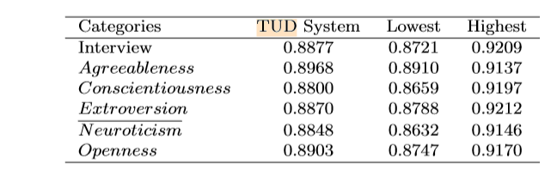
Quantitative System
The building blocks of the TUD predictive model encompass four feature representations; OpenFace, MEI, Readability, and Text. Employing the 6000 training set videos, for each representation, a separate model was trained to predict personality traits and interview scores
For a ﬁnal prediction score, late fusion is used and the predictions made by the four diﬀerent models were averaged.
As the goal of the system is to trace back the prediction scores to each underlying feature, linear models were selected. Linear regression is a commonly used model in the social sciences literature after applying PCA with 90% variance
.

Slide 19
Qualitative System:
While the model gives indicators on the strongest linear coeﬃcients, the assessments it was trained on are made by external observers (crowdsourcing workers), which poses a very diﬀerent situation from the assessment settings in the formal psychology studies
It may be possible to aggregate feature observations to higher-level descriptions (in particular, regarding AU detections, as combinations of AUs may indicate higher-level emotional expressions), but as this would increase the complexity of the model, only a basic explanation using individual low-level features was kept.
To reﬂect major indicators from the linear model in the description, for each representation (OpenFace, MEI, Readability, Text) the two largest linear regression coeﬃcients that were picked. For PCA dimensions corresponding to these coeﬃcients, the features contributing most strongly to these dimensions were traced back, and their sign is checked. For these features, a short notice is added to the description, expressing how the feature commonly aﬀects the ﬁnal scoring

